Slide 1
Sorting

Slide 2
More sorting
MANY sorts out there
Should have seen
Insert, bubble, selection, merge, heap, quick, radix already
But…
Is there a time we prefer insertion sort over merge sort?
Can “break” quick sort and force that O(n²) runtime?
Should we mix sorts for optimum performance?
Yes!

Slide 3
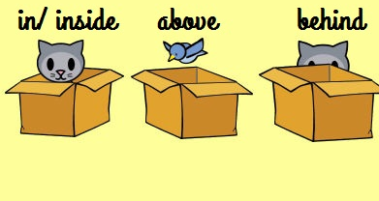
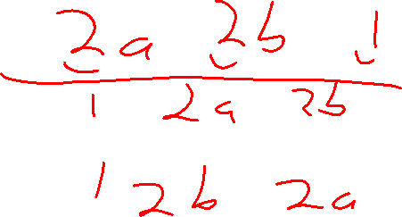
What makes a sort good?
Fast
  Obviously…
  But more specifically, fast for our data
Memory use
  A In-place sort says it doesn’t use any more memory that the original array plus a few temporary values
  Important in embedded devices that don’t have much memory
Stability (stable sort)
  Are duplicate sort values moved?
  Why does this matter?
??

Slide 4

First, the O(n²) sorts
These are generally easier to code than the other sorts
The big questions is, when are they preferred?

Slide 5
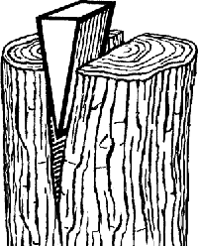

Insertion sort
Advantages
Disadvantages
Ω(n)
Smaller upfront constant than O(n lg n) sorts
Stable sort
In-place memory use
O(n²) in the normal case
When is it Ω(n)?

Slide 6


Selection sort
Advantages
Disadvantages
Smaller upfront constant than even the insertion sort
In-place memory use
Θ(n²)
Can’t stop early
Unstable sort

Slide 7

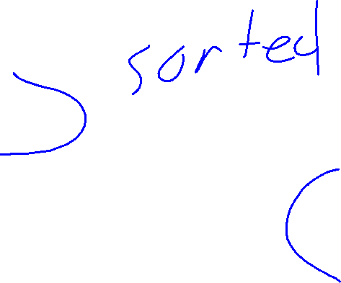
Bubble sort
Advantages
Disadvantages
??
Ω(n)
Most variations are stable sort
In-place memory use
O(n²) in the normal case
Larger upfront constant than the insertion sort
Could be unstable
  To be fair, this is also true of insertion sort, but I haven’t seen it
When is it Ω(n)?

Slide 8
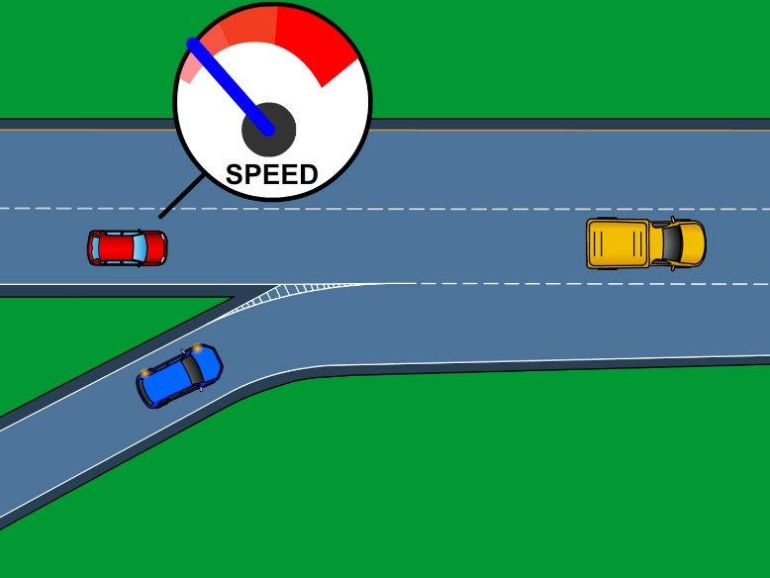
Merge sort
Advantages
Disadvantages
Θ(n lg n) run time
Relatively easy to code
Stable sort
ALWAYS Θ(n lg n)
Not that easy to debug
Large upfront constant
Memory hog

Slide 9
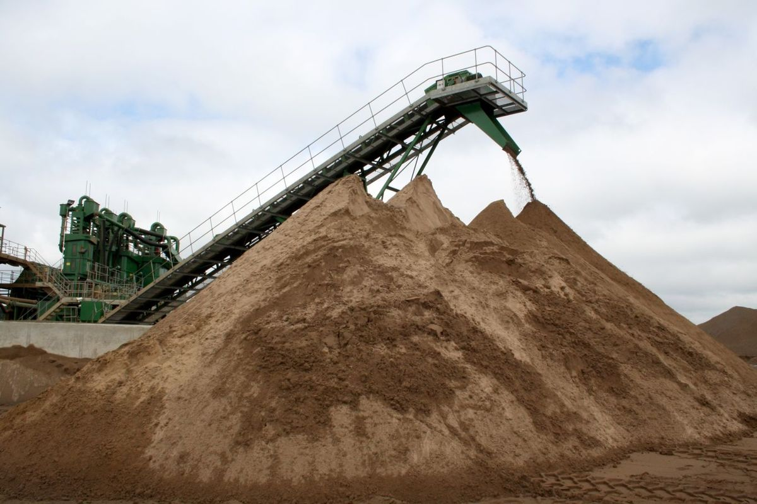
Heap sort
Advantages
Disadvantages
Θ(n lg n) run time
Useful if you need the heap for something else
Smaller upfront constant than merge sort
In-place memory use
Unstable sort
Some arguments about it being easier to debug

Slide 10
Quick sort
Advantages
Disadvantages
Ω(n lg n)
Average run time of O(n lg n)
Smaller upfront constant than merge sort
In-place memory use
Worse case O(n²)
Not that easy to debug
Unstable sort
Sorted, or just got VERY unlucky
When is it O(n²) ?

Slide 11
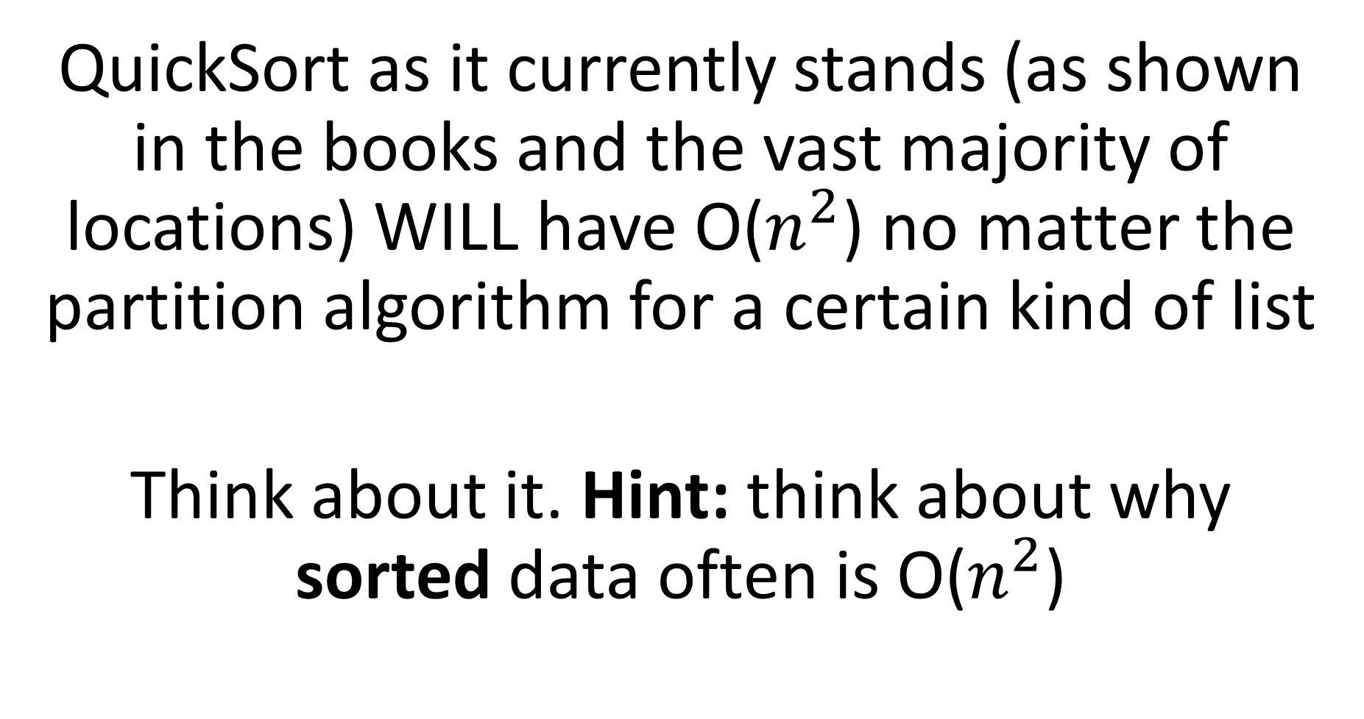
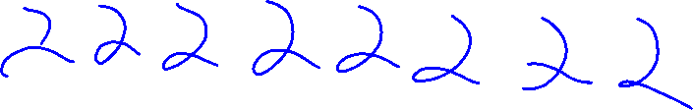
Challenge question: Breaking Quicksort
QuickSort as it currently stands (as shown in the books and the vast majority of locations) WILL have O($n^{2}$) no matter the partition algorithm for a certain kind of list
Think about it. Hint: think about why sorted data often is O($n^{2}$)
(There is a fix, but it requires changing other parts of the code)

Slide 12
Can these affect our choices?
If you know your data, you can pick the best option.
First up, a odd items on quick versus heap sort!
Then, double-use sorts!

Slide 13
Heap sort versus Quick Sort
Hmmm, it looks like Heap may beat out Quick sort, so why do we see quick sort much more often?
??
Hint: What is actually different about them…
Answer? The up front constant?
  Er…heap sort actually has a lower upfront constant!
  …OK, OK, if the data is sorted, then Quick has a lower upfront constant.., but average case?

Slide 14
Heap sort versus Quick Sort
Hmmm, it looks like Heap may beat out Quick sort, so why do we see quick sort much more often?
Hint: Think about where the comparisons are made
Hint 2: What indices are being compared?
Answer? Quick sort has locality!
Yes! Quick sort accessing thing in an adjacent manner. Heap does not. That is very costly in large lists!
If your list is < 4KB, you should be safe (granted, this keeps growing)

Slide 15

Double-use sorts
Are there other ways to double-use sorts?

Slide 16

Double-use sorts
Insertion sort is MUCH faster than merge sort for small n
Why?
Often, we can partially sort with one method, to make it ideal for another sort (we see this a LOT with the O(n) sorts).
Recycling, not just for trash anymore!

Slide 17
Double-use sorts
How can we make use of the Ω(n) of insertion sort and bubble sort?
Better question, how sorted should the list be before we should use this sorts?
??

Slide 18
Partial sort?
Insertion, selection, and bubble sort all have a guaranteed partially sorted list after each pass
How is that useful to us?
If we need less than the top/bottom lg n of them, we should use these sorts!
Be can we do better?
Yes, we can!
Optional Material: Ith order statistic

Slide 19
Whew, now the question is, what to pick?
What is the best sort for each of the following cases?
And why?
??
Resort a phonebook after each week?
Sort the ranking of the last 50 years movie’s on an embedded device?
Find the best skiers at a large resort, and display in alphabetical order
Sort a 1000 items in an inventory

Slide 20
Recap
Practice choosing the best sort

